Slide 1

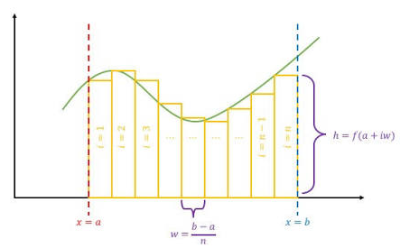
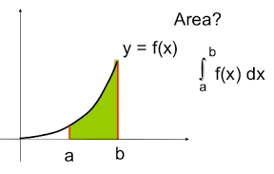
Multiple Integrals
A single integral adds up quantities along a line. A double integral adds up quantities over an area. A triple integral adds up quantities throughout a volume..

Slide 2
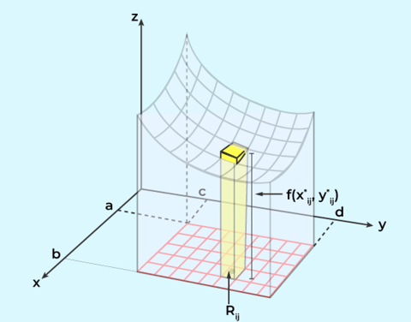
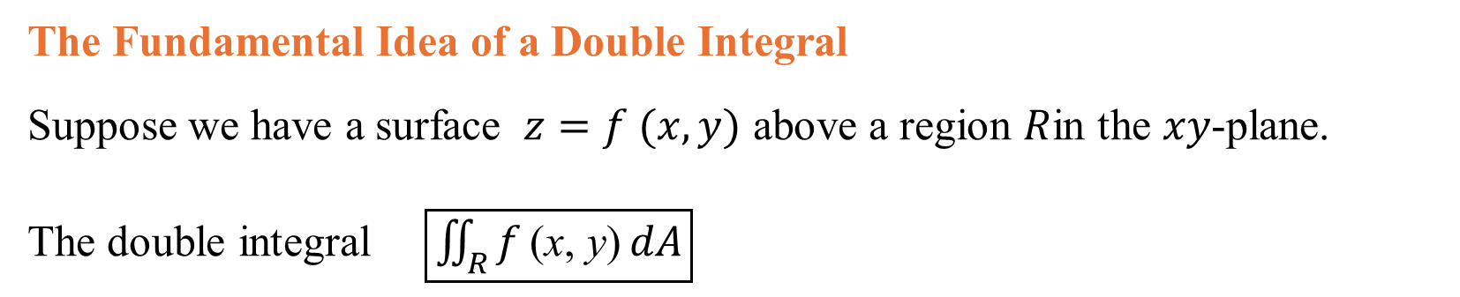
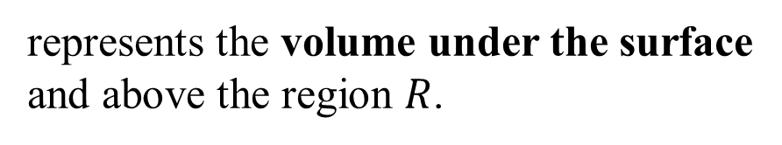
The Fundamental Idea of a Double Integral
Suppose we have a surface $z=f (x,y)$ above a region $R$in the $xy$-plane.
The double integral $\boxed{\iint_{R}{f}\text{(x, y)} dA}$
represents the volume under the surface and above the region $R$.

Slide 3
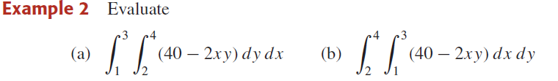
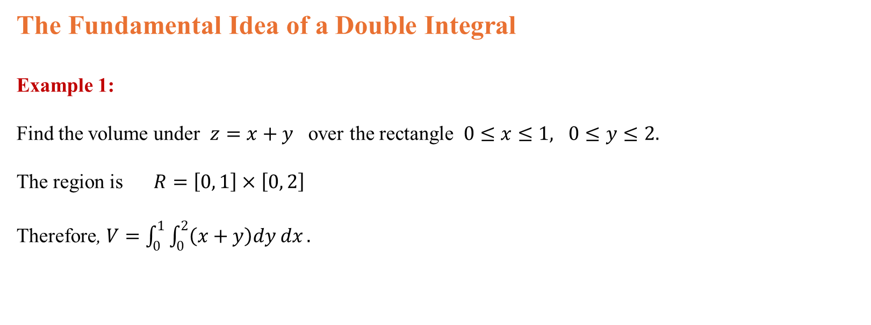
The Fundamental Idea of a Double Integral
Example 1:
Find the volume under $z=x+y$ over the rectangle $0≤x≤1, 0≤y≤2.$
The region is $R=\left[0, 1\right]×\left[0, 2\right]$
Therefore, $V=\int_{0}^{1}{\int_{0}^{2}{\left(x+y\right)dy dx}}.$

Slide 4
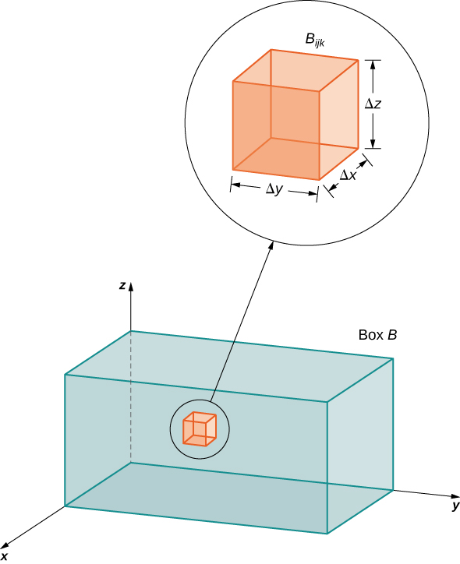
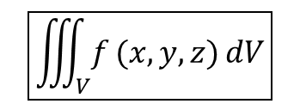
The Fundamental Idea of a Tripple Integral
A triple integral adds up infinitely many tiny quantities throughout a three-dimensional region (a solid). A double integral works over an area. A triple integral works over a volume.
The general form is
$$\boxed{\iiint_{V}{f}(x,y,z) dV}$$
where $V$is a three-dimensional region and $dV=dx dy dz$

Slide 5
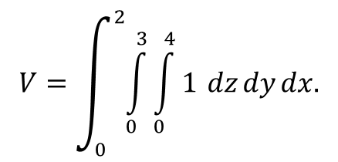
The Fundamental Idea of a Tripple Integral
Triple Integral of 1 Gives Volume
f ( x, y, z) =1,
Example: A rectangular box
Suppose $0≤x≤2, 0≤y≤3, 0≤z≤4.$ The solid is a box with dimensions $2×3×4$. Therefore
$$V=\int_{0}^{2}{\int_{0}^{3}{\int_{0}^{4}{1}}} dz dy dx.$$

Slide 6
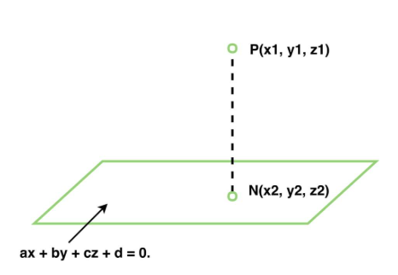
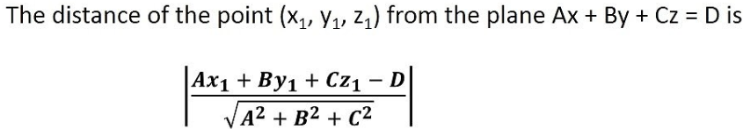
Distance from a Point to a Plane : distance PN is the shortest or perpendicular from point P to the plane.
Foot of the Perpendicular: Point N is the foot of perpendicular

